Slide 1
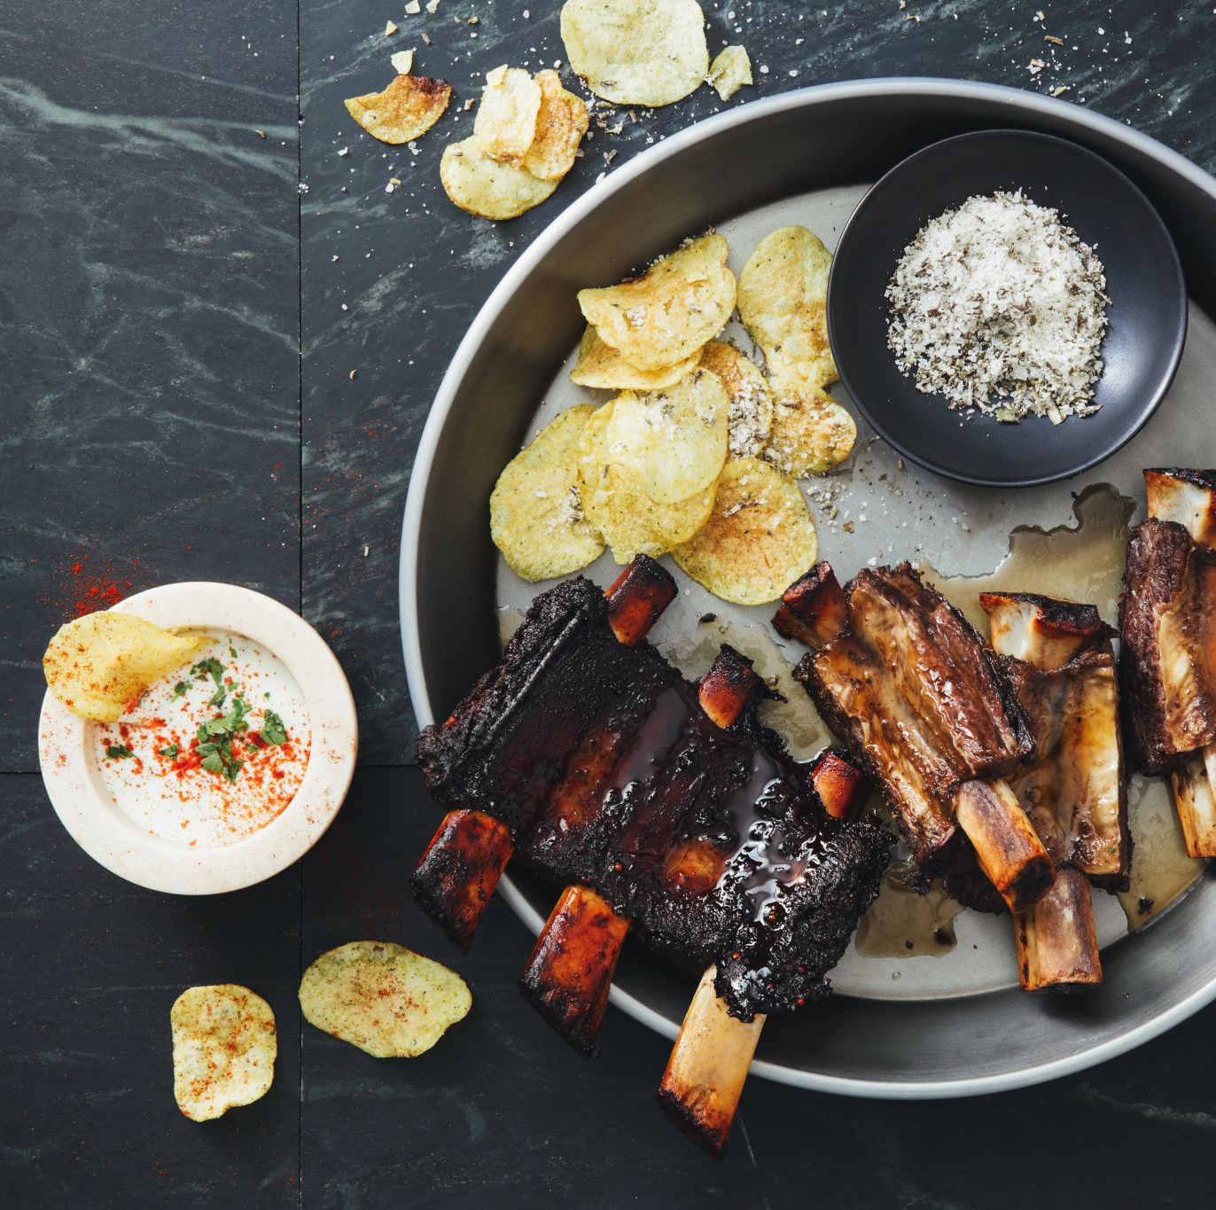
Predicting Recipes that Lead to High Website Traffic
Kaileigh Stopa

Slide 2
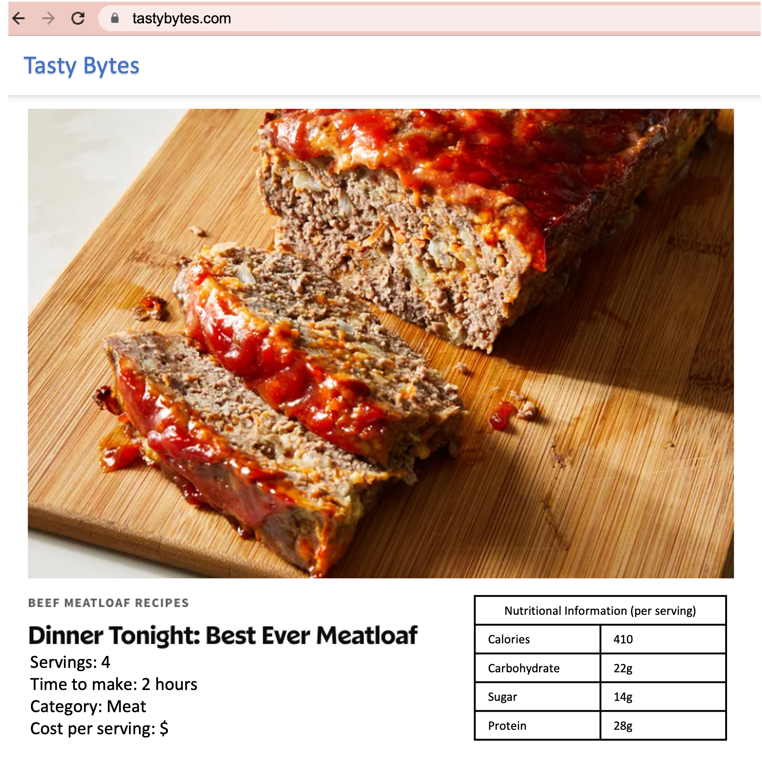
Business Impact
The recipe posted to the homepage can increase traffic to other parts of the website by as much as 40%
More traffic means more subscriptions
Project Goals:
Build a model that can predict which recipes will lead to high website traffic
Correctly predict high traffic recipes 80% of the time

Slide 3
Understanding the Data
Before building a model, we want to understand the dataset
Recipe features:
Calories per serving
Carbohydrate (grams)
Sugar (grams)
Protein (grams)
Recipe category
Number of Servings
What can the data tell us about the factors that contribute to a recipe’s success in generating high traffic?

Slide 4
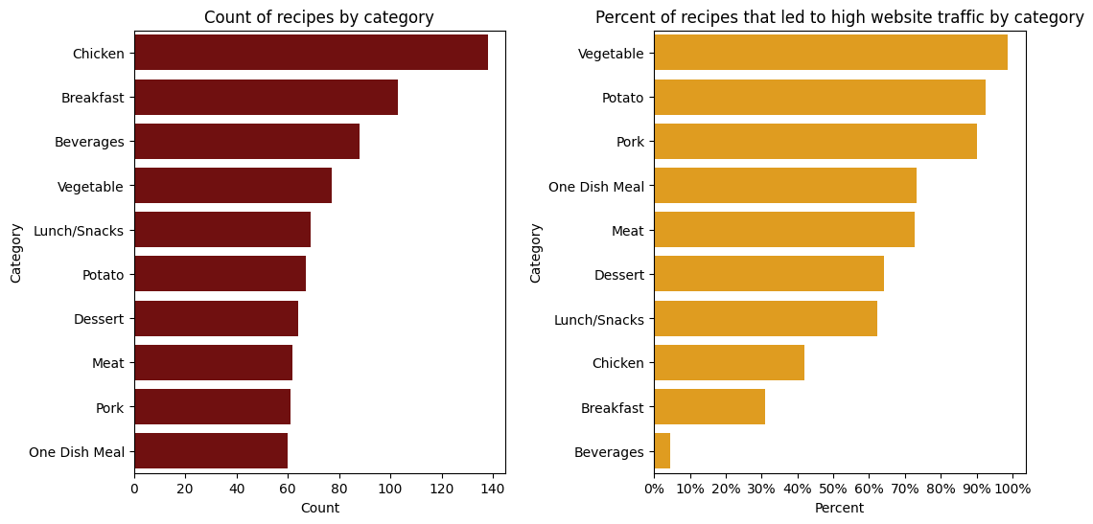

Slide 5
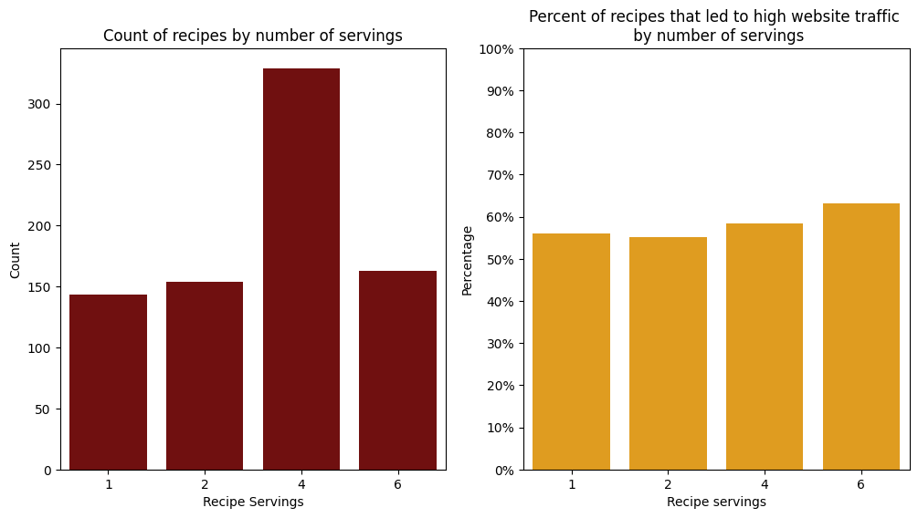

Slide 6
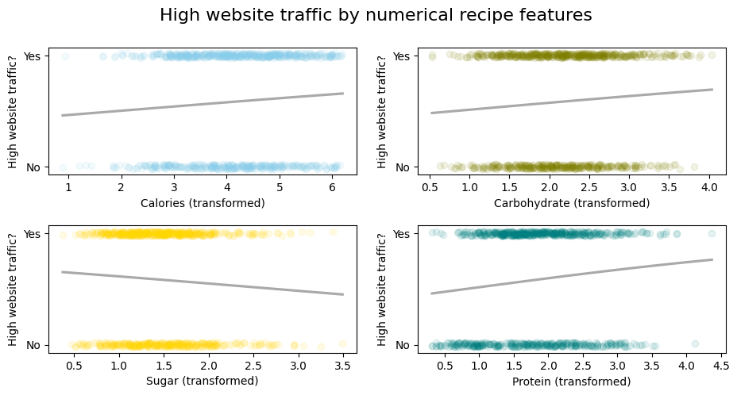

Slide 7
We used a subset of the data to train the model
Training Data Recipe Features:
Category
Calories
Model
Carbohydrate
Protein
Servings
Sugar
High Traffic

Slide 8
Test Data
Recipe Features:
We used the remaining data to test the model
Category
Calories
Trained
Model
Carbohydrate
Protein
Servings
High Traffic
Sugar
Compare with true values: how accurate were the model’s predictions?
?

Slide 9
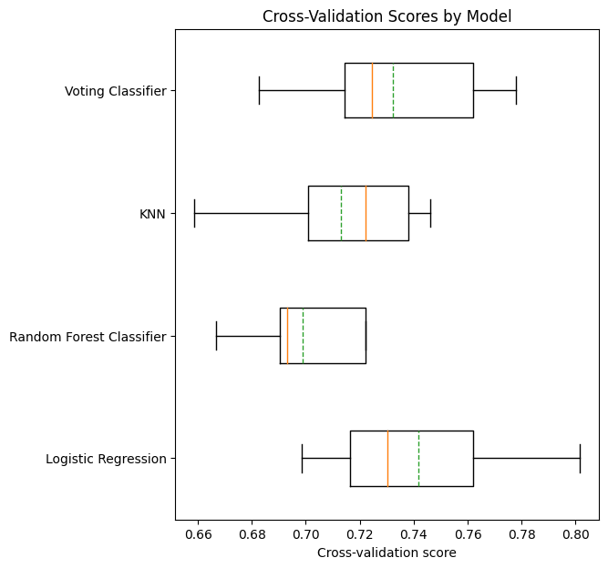
Model Evaluation
Our logistic model was 77.22% accurate at predicting recipes that would lead to high traffic in our test data
Our other models performed slightly worse
We would generally expect this model to perform with 70-80% accuracy

Slide 10
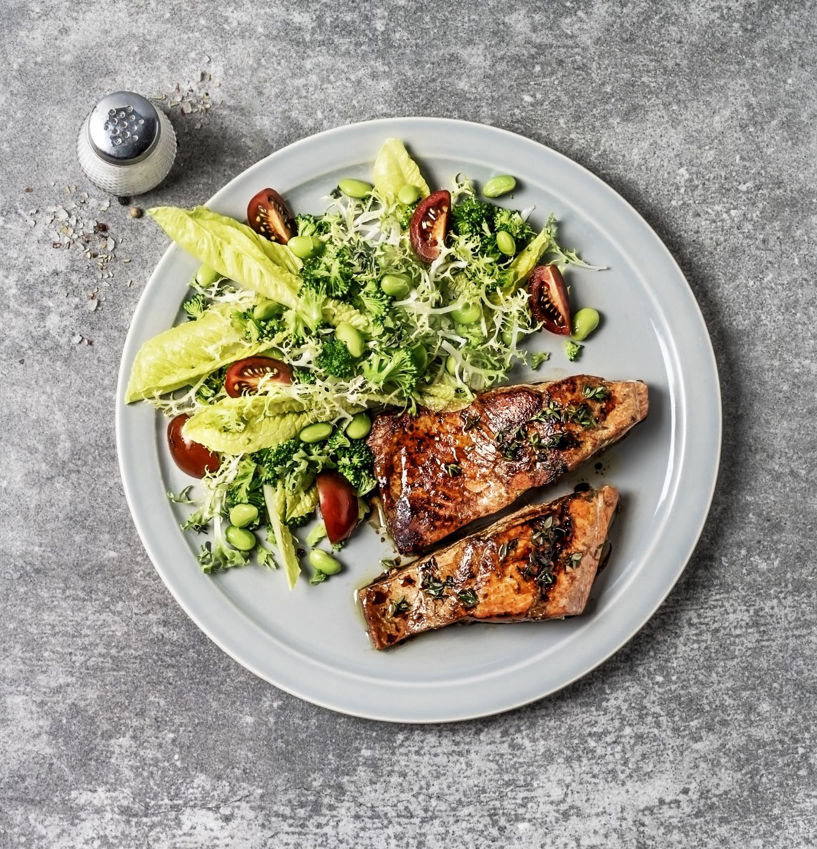
Model Evaluation & Recommendations
Our model was able to confirm what we saw while exploring the dataset:
Vegetable, Potato, and Pork recipes increase website traffic
Conversely, Beverage, Breakfast, and Chicken recipes do not
Recipes with high protein and low sugar increase website traffic
Number of servings is not very important
The business should take these factors into account when deciding what recipe to post to the home page

Slide 11

Improving Model Performance
How can we get to that 80% mark consistently?
Collect more data for training the model
Work together to understand existing data, try to correct erroneous values so we lose less data
Further in-depth testing of different algorithms
Any questions?

